Slide 1
Second Year B. Tech. Advanced Data Structures (CS228)
By
Dr. Pramod D. Ganjewar
Senior Assistant Professor,
School of Computer Engineering,
MIT Academy of Engineering, Alandi(D.),Pune

Slide 2
Unit – 2 Height Balanced and Multiway Tree AVL Tree

Slide 3
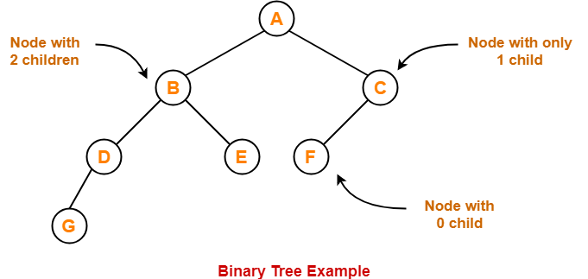
Binary Tree
Binary Tree
Binary tree is a special tree data structure in which each node can have at most 2 children.
Thus, in a binary tree, Each node has either 0 child or 1 child or 2 children.

Slide 4
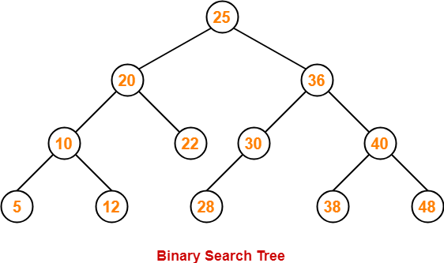
Binary Search Tree
Binary Search Tree
Binary Search Tree is a special kind of binary tree in which nodes are arranged in a specific order.
In a binary search tree (BST), each node contains-
Only smaller values in its left sub tree
Only larger values in its right sub tree

Slide 5
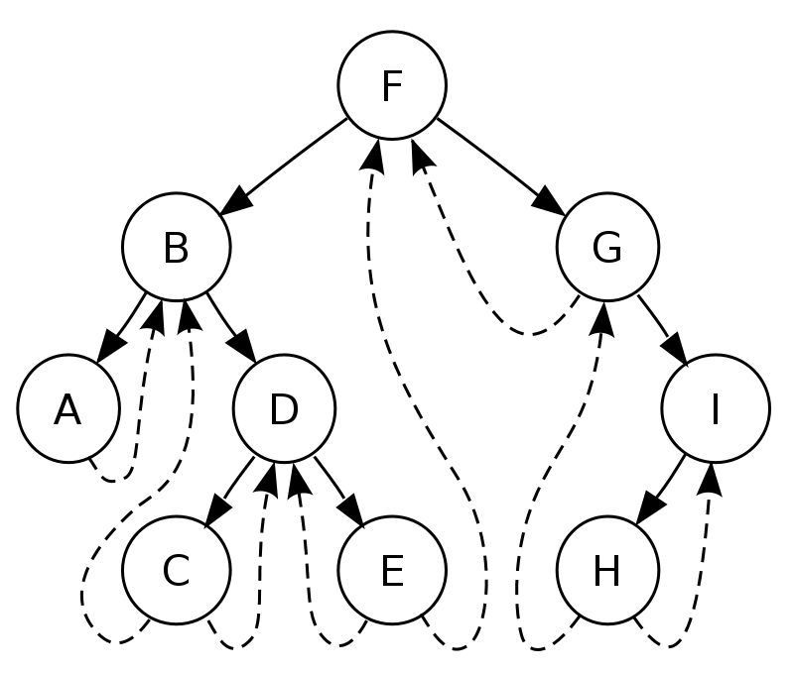
Threaded Binary Tree
Threaded Binary Trees by name suggests that the nodes are connected with threads / links.
This uses linked representation of the binary tree to make it threaded binary tree.
A threaded binary tree is defined as follows:
"A binary tree is threaded by making all right child pointers that would normally be null point to the in-order successor of the node (if it exists), and all left child pointers that would normally be null point to the in-order predecessor of the node.“
^{In-order – A,B,C,D,E,F,G,H,I}
In-order Successor – Immediate next in In-Order Traversal,
In-order Predecessor – Immediate previous in the In-Order Traversal.

Slide 6
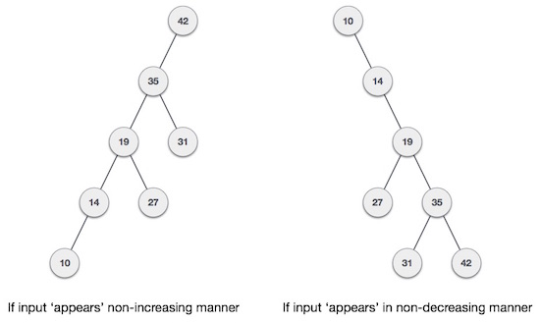
AVL Tree Basics
What if the input to binary search tree comes in a sorted (ascending or descending) manner?
It will then look like as shown in Fig.
It is observed that BST's worst-case performance is closest to linear search algorithms, that is Ο(n).
In real-time data, we cannot predict data pattern and their frequencies. So, a need arises to balance out the existing BST.

Slide 7
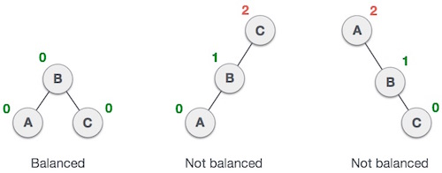
AVL Tree Basics
Named after their inventor Adelson, Velski & Landis, AVL trees are height balancing binary search tree.
AVL tree checks the height of the left and the right sub-trees and assures that the difference is not more than 1 i.e. it should be -1, 0 and +1.
This difference is called the Balance Factor.
Here we see that the first tree is balanced and the next two trees are not balanced −

Slide 8
AVL Tree Basics
In the second tree, the left subtree of C has height 2 and the right subtree has height 0, so the difference is 2.
In the third tree, the right subtree of A has height 2 and the left is missing, so it is 0, and the difference is 2 again.
AVL tree permits difference (balance factor) to be up to 1.
Balance_Factor = height(left-subtree) − height(right-subtree)
If the difference in the height of left and right sub-trees is more than 1, the tree is balanced using rotation techniques.

Slide 9
AVL Tree Rotations
To balance itself, an AVL tree may perform the following four kinds of rotations −
Left Rotation
Right Rotation
Left-Right Rotation
Right-Left Rotation
The first two rotations are single rotations and the next two rotations are double rotations.
To have an unbalanced tree, we need a tree of at least height 2.
With this simple tree, let's understand them one by one.

Slide 10
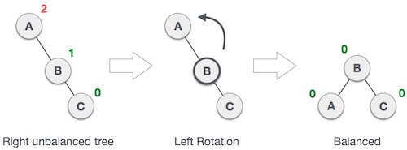
AVL Tree Rotations ( Left Rotate)
Left Rotation
If a tree becomes unbalanced, when a node is inserted into the right subtree of the right subtree, then we perform a single left rotation −
In our example, node A has become unbalanced as a node is inserted in the right subtree of A's right subtree. We perform the left rotation by making A the left-subtree of B.

Slide 11
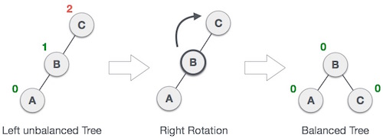
AVL Tree Rotations (Right Rotate)
Right Rotation
AVL tree may become unbalanced, if a node is inserted in the left subtree of the left subtree. The tree then needs a right rotation.
As depicted, the unbalanced node becomes the right child of its left child by performing a right rotation.

Slide 12
AVL Tree Rotations ( LR Rotation)
Left-Right Rotation (LR Rotation)
Double rotations are slightly complex version of already explained versions of rotations.
To understand them better, we should take note of each action performed while rotation.
Let's first check how to perform Left-Right rotation.
A left-right rotation is a combination of left rotation followed by right rotation.

Slide 13

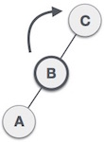
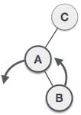
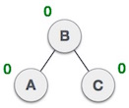
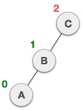
AVL Tree Rotations (LR Rotation)
State | Action
 | A node has been inserted into the right subtree of the left subtree. This makes C an unbalanced node. These scenarios cause AVL tree to perform left-right rotation.
 | We first perform the left rotation on the left subtree of C. This makes A, the left subtree of B.
 | Node C is still unbalanced, however now, it is because of the left-subtree of the left-subtree.
State | Action
 | We shall now right-rotate the tree, making B the new root node of this subtree. C now becomes the right subtree of its own left subtree.
 | The tree is now balanced.

Slide 14
AVL Tree Rotations ( RL Rotation)
Right-Left Rotation
The second type of double rotation is Right-Left Rotation.
It is a combination of right rotation followed by left rotation.

Slide 15

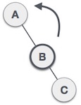
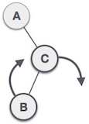
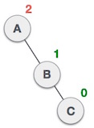
AVL Tree Rotations (RL Rotation)
State | Action
 | A node has been inserted into the left subtree of the right subtree. This makes A, an unbalanced node with balance factor 2.
 | First, we perform the right rotation along C node, making C the right subtree of its own left subtree B. Now, B becomes the right subtree of A.
 | Node A is still unbalanced because of the right subtree of its right subtree and requires a left rotation.
State | Action
 | A left rotation is performed by making B the new root node of the subtree. A becomes the left subtree of its right subtree B.
 | The tree is now balanced.

Slide 16
AVL Tree – Insertion
Steps to follow for insertion :-
Let the newly inserted node be w
1) Perform standard BST insert for w.
2) Starting from w, travel up and find the first unbalanced node. Let z be the first unbalanced node, y be the child of z that comes on the path from w to z and x be the grandchild of z that comes on the path from w to z.
3) Re-balance the tree by performing appropriate rotations on the subtree rooted with z. There can be 4 possible cases that needs to be handled as x, y and z can be arranged in 4 ways. Following are the possible 4 arrangements:
a) y is left child of z and x is left child of y (Left Left Case / Left Unbalanced / Right Rotation)
b) y is left child of z and x is right child of y (Left Right Case)
c) y is right child of z and x is right child of y (Right Right Case / Right Unbalanced / Left Rotation)
d) y is right child of z and x is left child of y (Right Left Case)

Slide 17
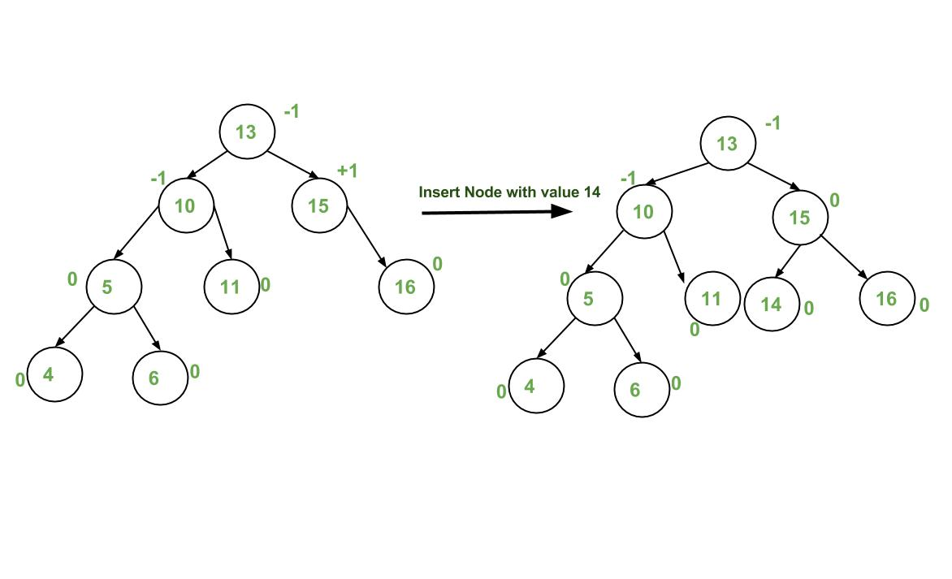
AVL Tree – Insertion (Case – 1)

Slide 18
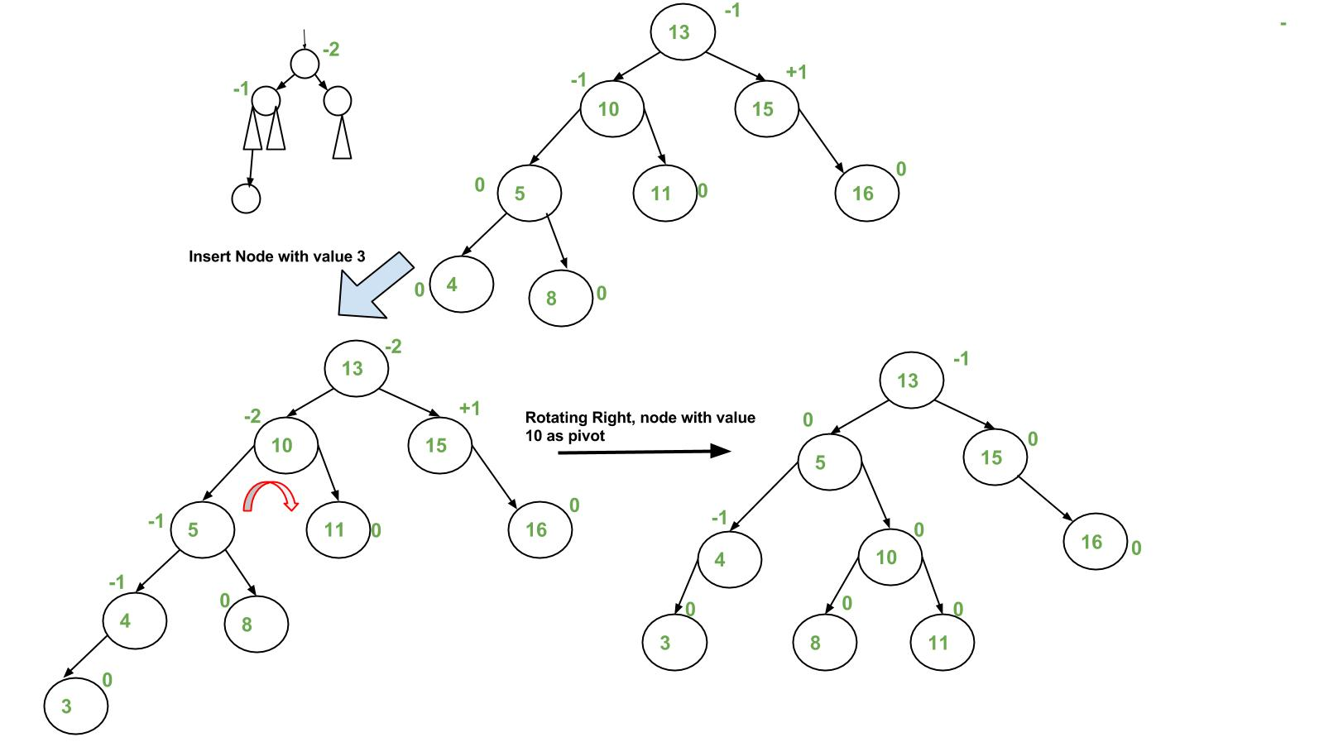
AVL Tree – Insertion (Case – 2)

Slide 19
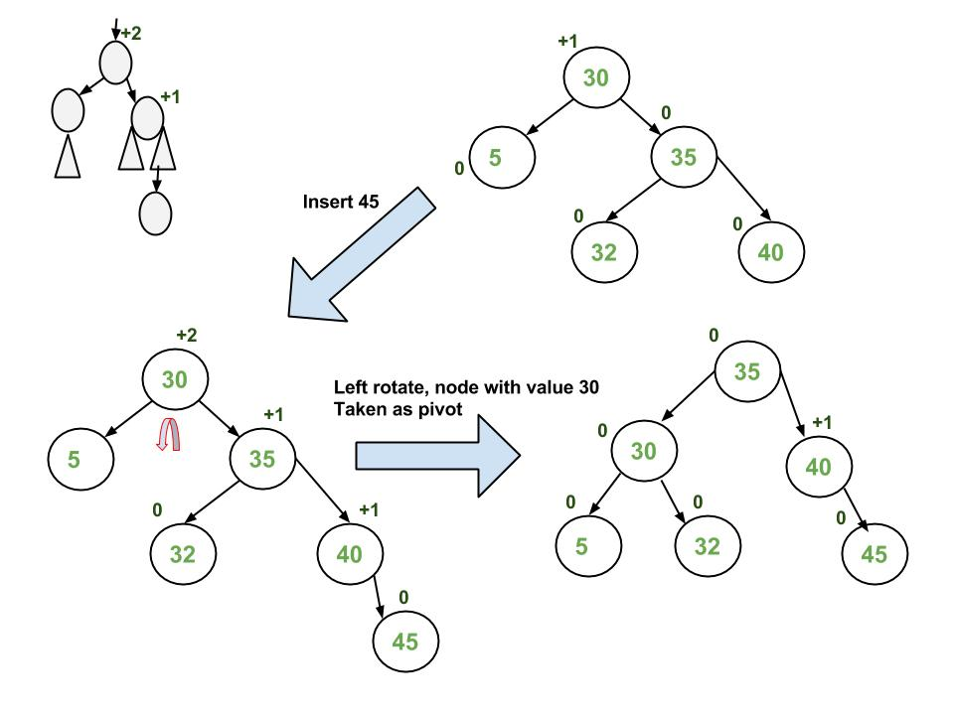
AVL Tree – Insertion (Case – 3)

Slide 20
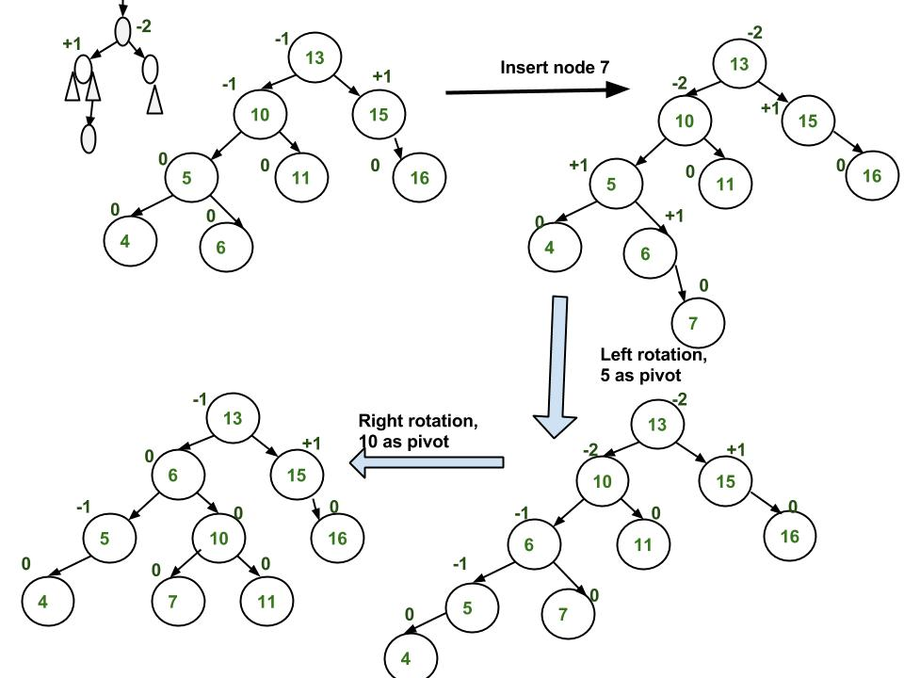
AVL Tree – Insertion (Case – 4)

Slide 21
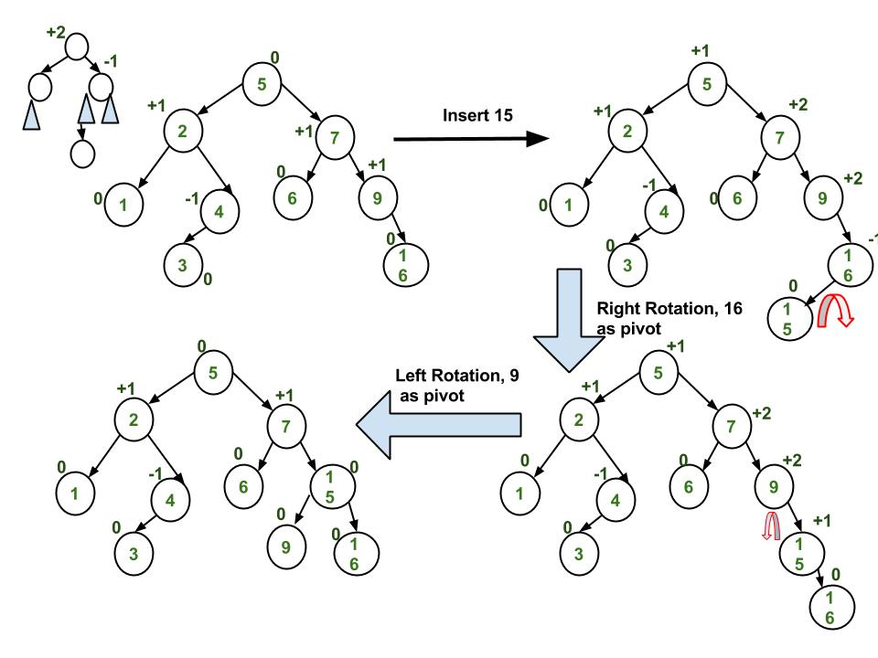
AVL Tree – Insertion (Case - 5)

Slide 22

Example : Construction of AVL Tree by inserting numbers from 1 to 8

Slide 23
Example : Construction of AVL Tree by inserting numbers from 1 to 8

Slide 24
Example : Construction of AVL Tree by inserting numbers from 1 to 8

Slide 25
AVL Tree – Deletion
Steps to follow for deletion
Let w be the node to be deleted
1) Perform standard BST delete for w.
2) Starting from w, travel up and find the first unbalanced node. Let z be the first unbalanced node, y be the larger height child of z, and x be the larger height child of y. Note that the definitions of x and y are different from insertion here.
3) Re-balance the tree by performing appropriate rotations on the subtree rooted with z. There can be 4 possible cases that needs to be handled as x, y and z can be arranged in 4 ways. Following are the possible 4 arrangements
a) y is left child of z and x is left child of y (Left Left Case / Left Unbalanced / Right Rotation)
b) y is left child of z and x is right child of y (Left Right Case / LR Rotation)
c) y is right child of z and x is right child of y (Right Right Case / Right Unbalanced / Left Rotation)
d) y is right child of z and x is left child of y (Right Left Case / RL Rotation)
Like insertion, following are the operations to be performed in above mentioned 4 cases.
Note that, unlike insertion, fixing the node z won’t fix the complete AVL tree. After fixing z, we may have to fix ancestors of z as well.

Slide 26
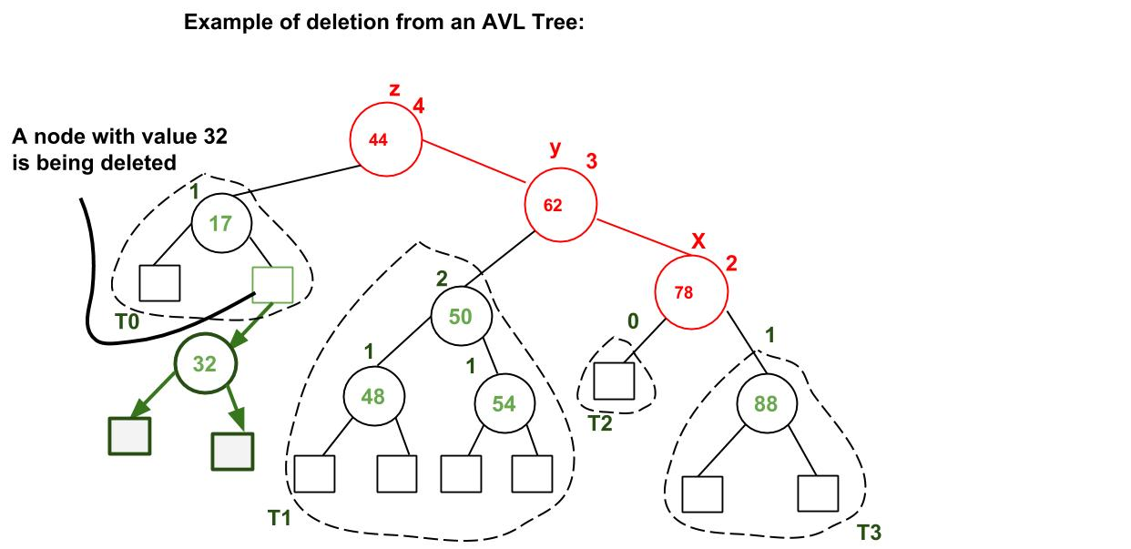
AVL Tree – Deletion (Step – 1)
A node with value 32 is being deleted.
After deleting 32, we travel up and find the first unbalanced node which is 44.
We mark it as z, its higher height child as y which is 62, and y’s higher height child as x which could be either 78 or 50 as both are of same height.
We have considered 78.
Now the case is Right Right, so we perform left rotation.

Slide 27
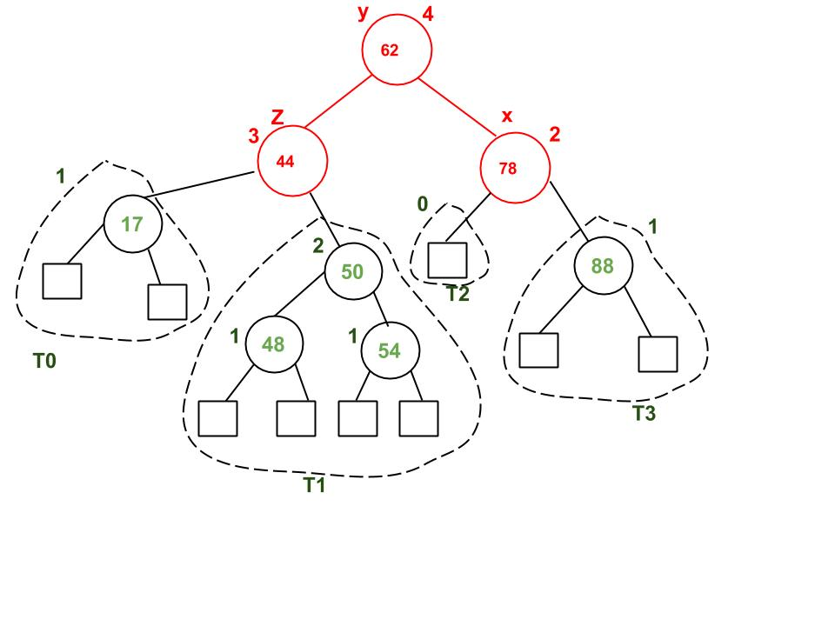
AVL Tree – Deletion (Step – 2)

Slide 28
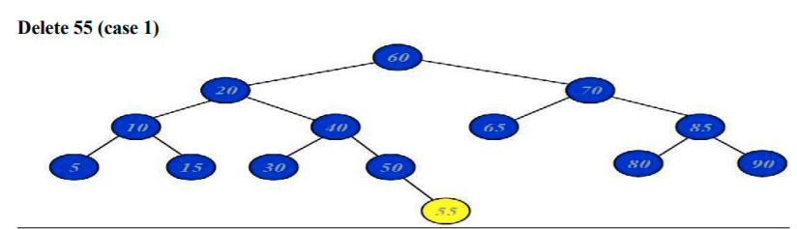
Example : Deletion from AVL Tree
Case 1 : Deletion of Leaf Node from AVL Tree

Slide 29
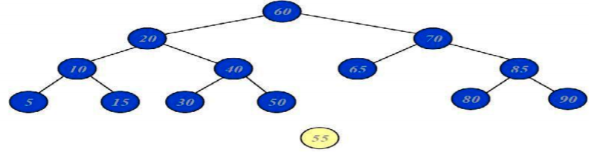
Example : Deletion from AVL Tree
Case 1 : Deletion of Leaf Node from AVL Tree

Slide 30
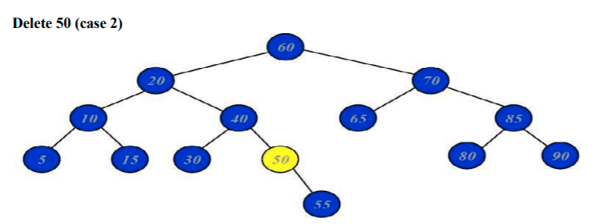
Example : Deletion from AVL Tree
Case 2 : Deletion of Node having Single Child

Slide 31
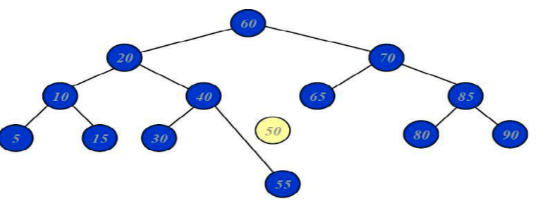
Example : Deletion from AVL Tree
Case 2 : Deletion of Leaf Node having Single Child

Slide 32
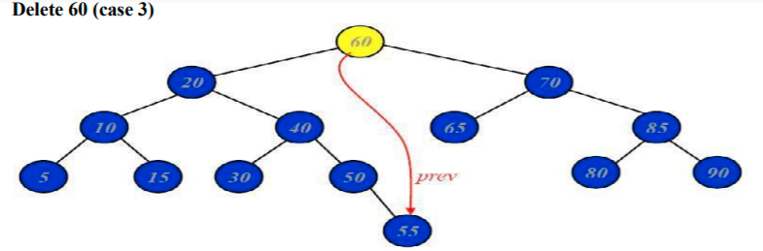
Example : Deletion from AVL Tree
Case 3 : Deletion of Root Node from AVL Tree

Slide 33
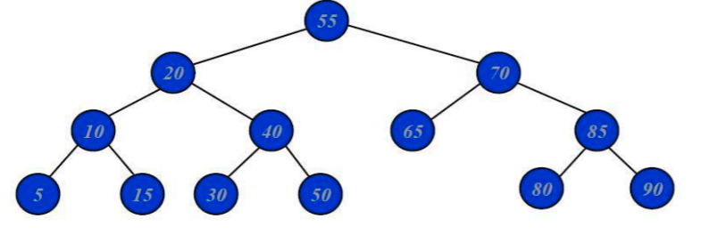
Example : Deletion from AVL Tree
Case 3 : Deletion of Root Node from AVL Tree

Slide 34
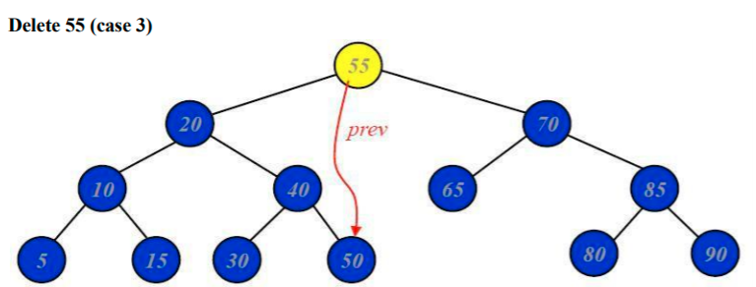
Example : Deletion from AVL Tree
Case 3 : Deletion of Root Node from AVL Tree

Slide 35
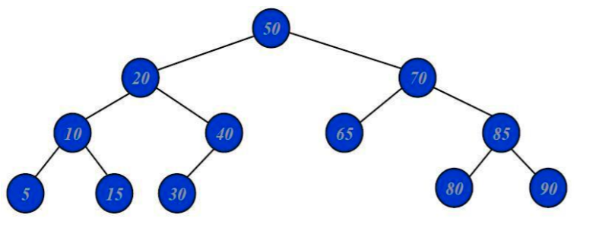
Example : Deletion from AVL Tree
Final Tree

Slide 36
Thank You

